Slide 1
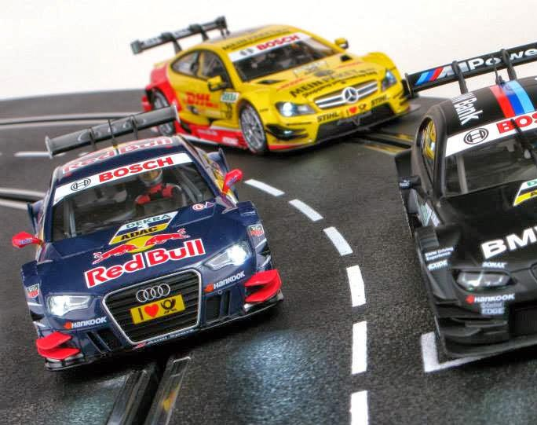
Using HTM to Perform Misbehavior Detection in Autonomous Vehicle Platoons
Ethan Swistak and Tushar Singhal

Slide 2
Week 3 – Progress Summary
Completed This Week | To-Do
Played with the trial, got more noticeable anomalies. Obtained 7 trials, 4 train, 1 val, and 2 test. Built HTM model and visualization infrastructure Implemented data averaging, achieving promising initial results. | Use larger compute infrastructure for swarming Implement LSTM model Determine detection threshold Evaluate accuracy on the data we have so far, is the comparison fair? Additional long trial with multiple anomalies

Slide 3
Dataset and preprocessing
Overall structure
Dataset
Datafields.txt
Trial #
Data.log
Meta
Hyperparameters of model
Cars maintain 45cm spacing
Target speed 200cm/s
Voltage level capped at 7
Preprocessing
Cut off first 30 seconds for warm up
Anomaly starts at 50-80 seconds and lasts up to 20 seconds

Slide 4

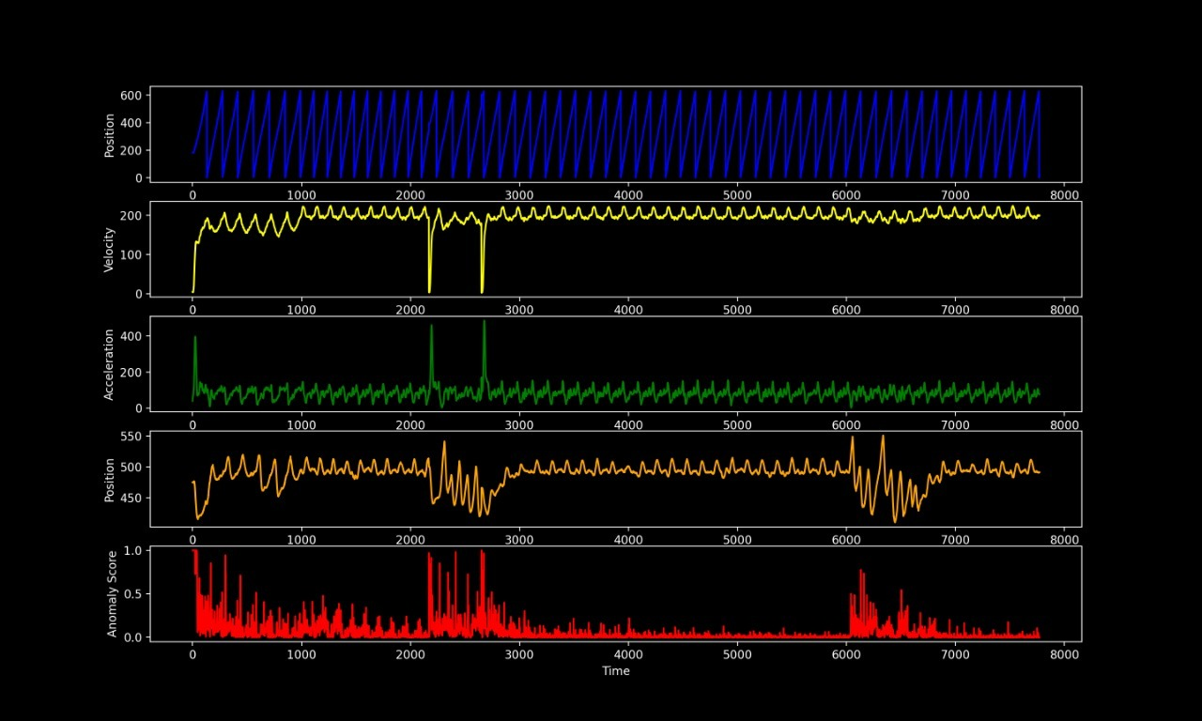
Results

